Slide 1

CONCEPTIAL DESIGN PRESENTATION

Slide 2

CANER POTUR CTO

Slide 3
Motor Drive System
Shooting System

Slide 4
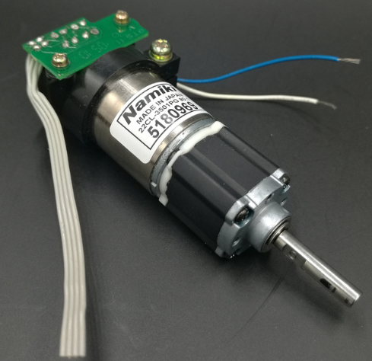
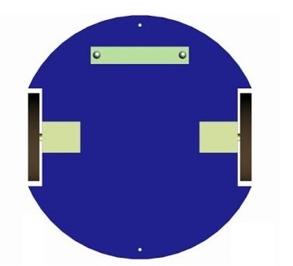
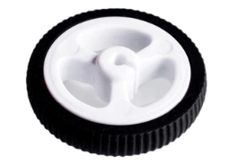
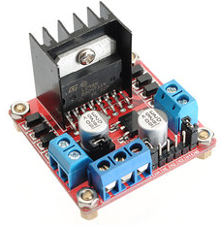
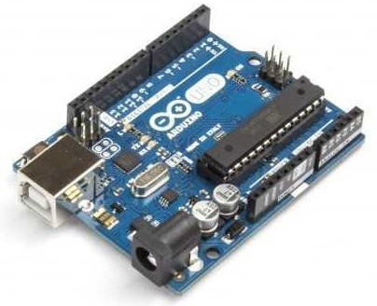
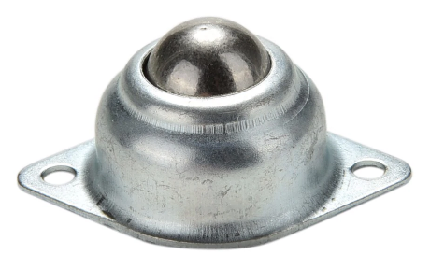
Motor Drive System: Differential Drive
Two DC motors
Two wheels
Two caster wheels
1 motor drive
1 Arduino Uno

Slide 5
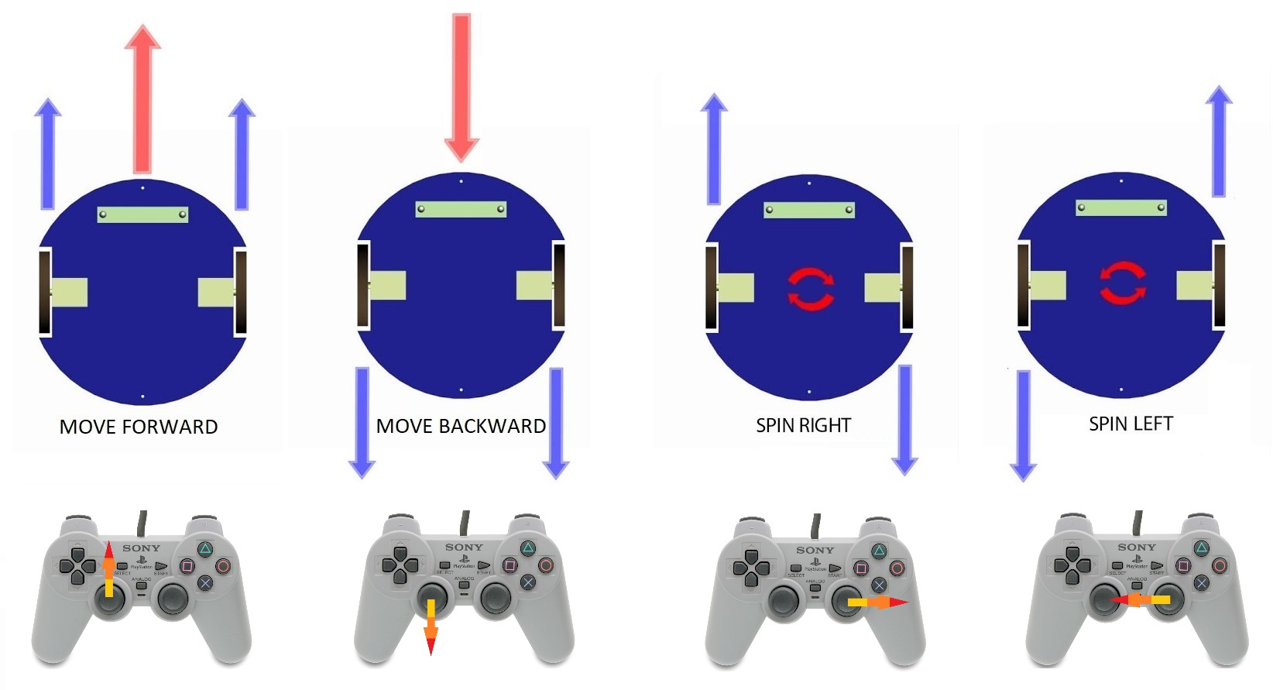

Slide 6


Slide 7

Defence

Slide 8
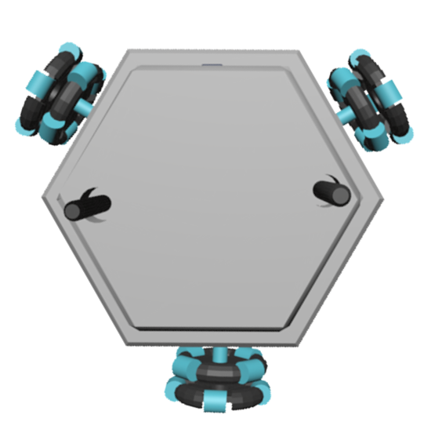
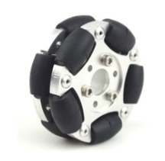
Alternate Solution: Holonomic Control
3 DC motors
2 motor drive
3 Omni wheels
1 Arduino Uno

Slide 9
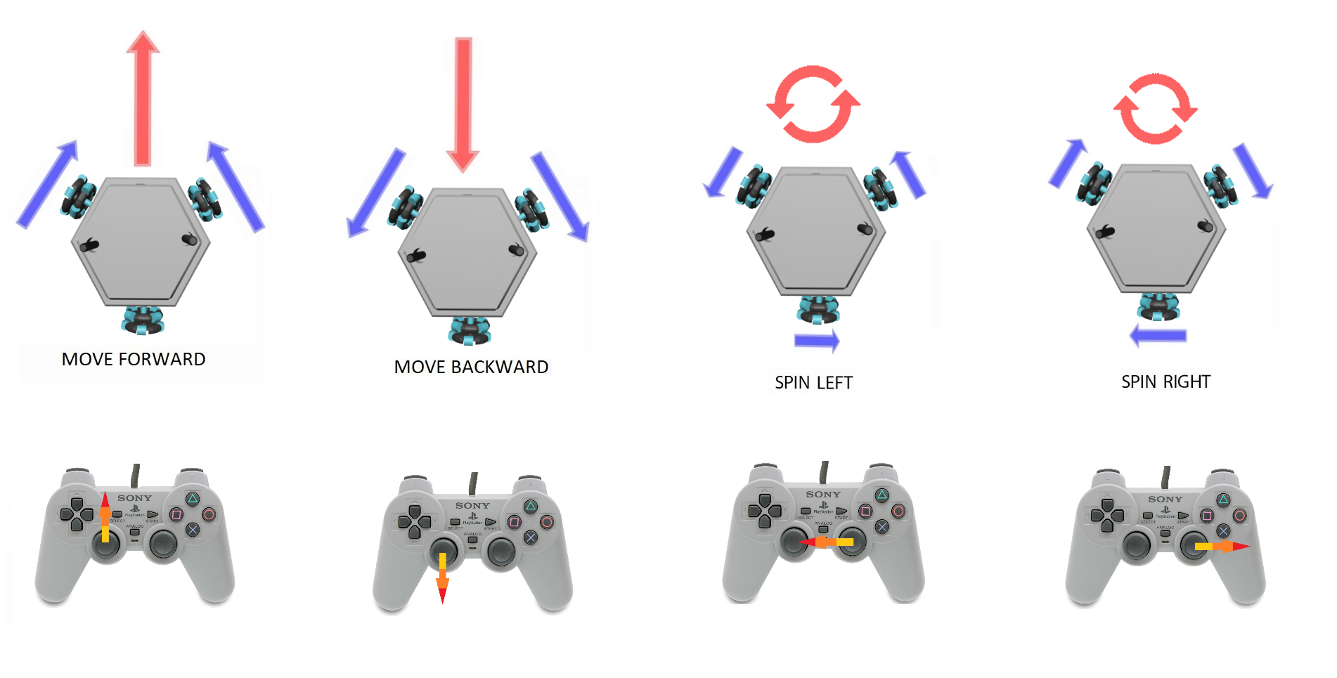

Slide 10
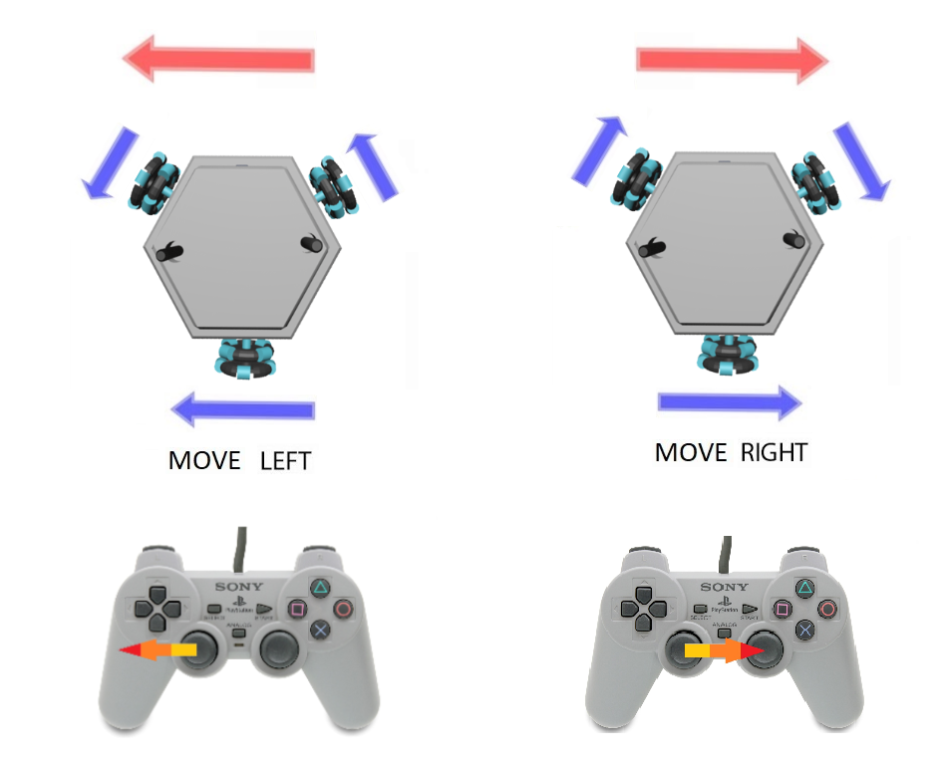

Slide 11

Shooting Systems

Slide 12
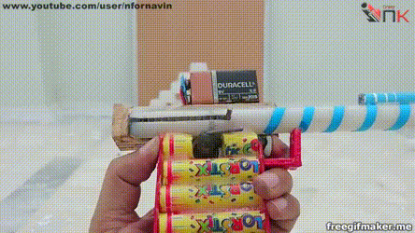
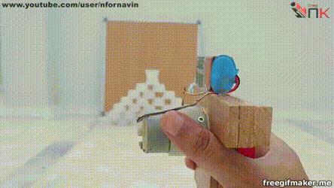
Spring Mechanics
Based on stored mechanical energy in a spring
Advantage:
Powerful shooting
Low Power Consumption
Disadvantage :
Slow reload

Slide 13

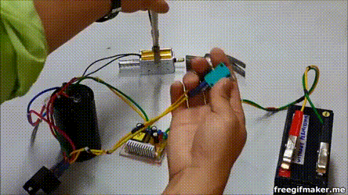
Solenoids
Based on creating a magnetic field by sending a current through a turn of wire
Advantages:
More powerful shooting
Small and lightweight
Disadvantages :
Operates at a high voltage and current,
Uses a lot of power
Due to internal resistance, heat is generated

